Slide 1
Kerberos–Authentication and Security
Hou In Choi,Changlin Li,Yuqian Zhang

Slide 2

The protocol was named after the character Kerberos from Greek mythology, the dangerous three-headed guard dog of Hades .
Kerberos is a network authentication protocol created by MIT, and uses symmetric-key cryptography to authenticate users to network services.
What is Kerberos?

Slide 3
Why Kerberos?
Easy to manage passwords centrally
Enhance security by ensuring no cleartext passwords are transmitted
Allow users to access different services with the same password

Slide 4
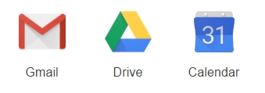
Manage key centrally & Using same password
Client
Client
Authentication
Server
Username
Password
Username
Password
Username
Password
Username
Password

Slide 5
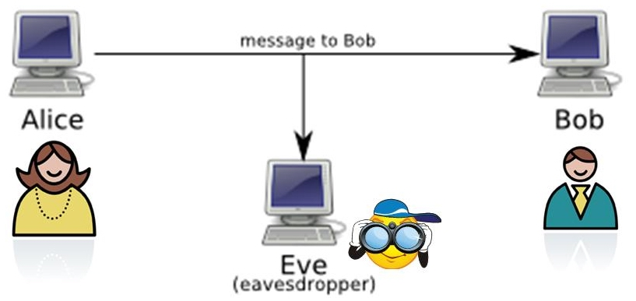
Passwords transmitting
Never transmitting Passwords !

Slide 6
Definition of Kerberos
Kerberos is a computer network authentication protocol which works on the basis of 'tickets' to allow nodes communicating over a non-secure network to prove their identity to one another in a secure manner.
It is based on client–server model and it provides mutual authentication—both the user and the server verify each other's identity. Kerberos protocol messages are protected against eavesdropping and replay attacks.

Slide 7
The goal of Kerberos
Avoid transmit unencrypted passwords over the network
Protect against the misuse of intercepted credentials
Make it more convenient for user by single sign-in

Slide 8
How kerberos relate to our class?
This is a client-server based model that we are familiar with.
And it is generally accepted and used in most operating systems.
Kerberos client and server principals:
Server principal - The Verifier principal (when used in verify/sign) or the Decryptor principal (when used in decryption/encryption)
Client principal - The Signer Principal (when used in verify/sign) or the Encryptor principal (when used in encryption/decryption)

Slide 9
About Encryption algorithms:
private key cryptography (“symmetric key") refers to an approach where the pair of entities exchanging messages share a single key used to encode and decode messages.
public key cryptography("asymmetric key") ,where the encoding and decoding keys are separate and difficult to derive from each other, allowing one of the keys to be made publicly available.
Private-key cryptography has the advantage of efficiency, but poses the fundamental problem of initially communicating the key to be used. For this reason, the two techniques are often combined.

Slide 10
Encryption used in Kerberos
The cryptographic algorithm typically employed in Kerberos is Data Encryption Standard (DES)
DES is a standard algorithm for "private-key" cryptography.
In Kerberos, a central authentication server certifies the identities of all entities
The functionality of Kerberos completely relies on the trustworthiness of the authentication server, which must know the password or key of every entity. It is therefore of paramount importance that the authentication server itself be completely secure.
user
Client application
a service

Slide 11
Terminology of Kerberos(prerequisite)
Authentication server(AS): A server that issues tickets for the user that want to access the server. it responds to requests from clients who do not have or do not send credentials with a request. It is usually used to gain access to the ticket-granting server (TGS) service by issuing a ticket-granting ticket (TGT). The AS usually runs on the same host as the key distribution center (KDC).
Key Distribution Center(KDC): Where the AS and TGS locate at.
Ticket-Granting-Server(TGS): A server that issues tickets for a desired service which are in turn given to users for access to the service. The TGS usually runs on the same host as the KDC.
Ticket-Granting-Ticket(TGT): A special ticket that allows the client to obtain additional tickets without applying for them from the KDC.

Slide 12
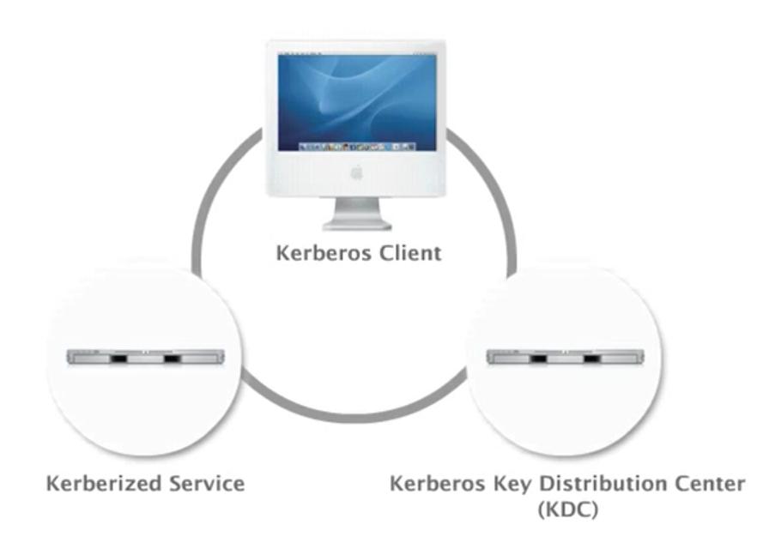

Slide 13
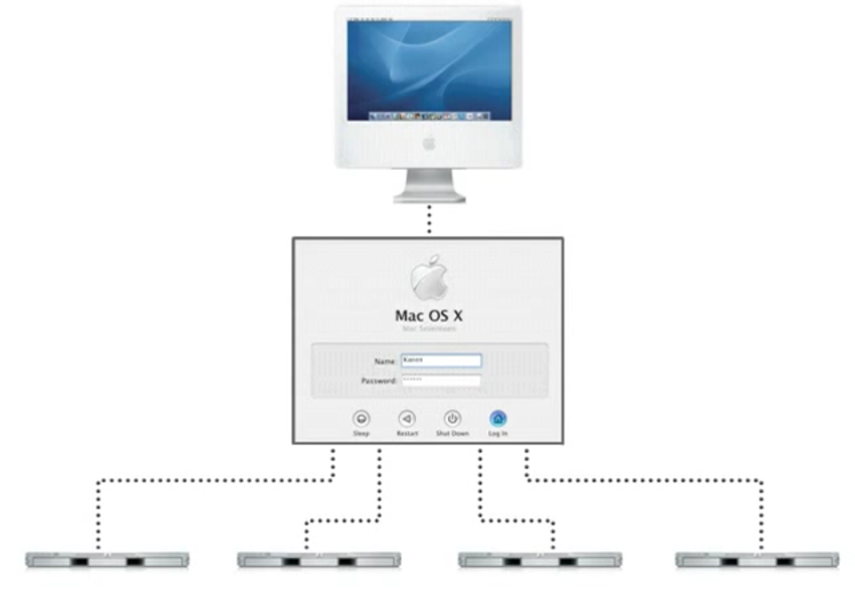

Slide 14
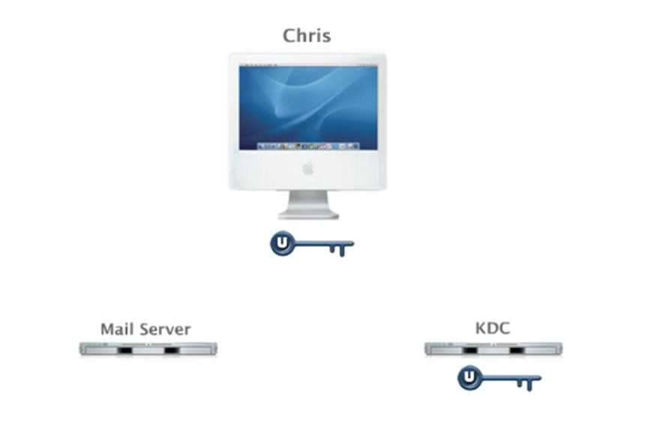

Slide 15
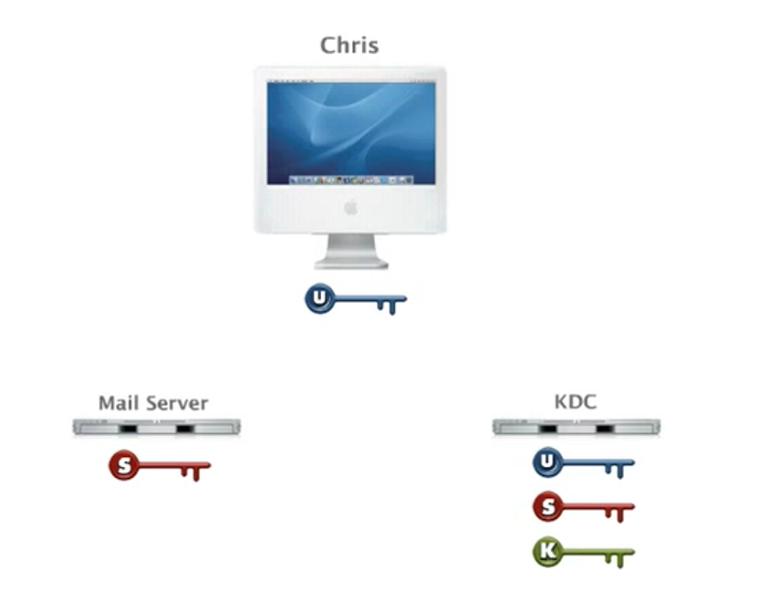

Slide 16
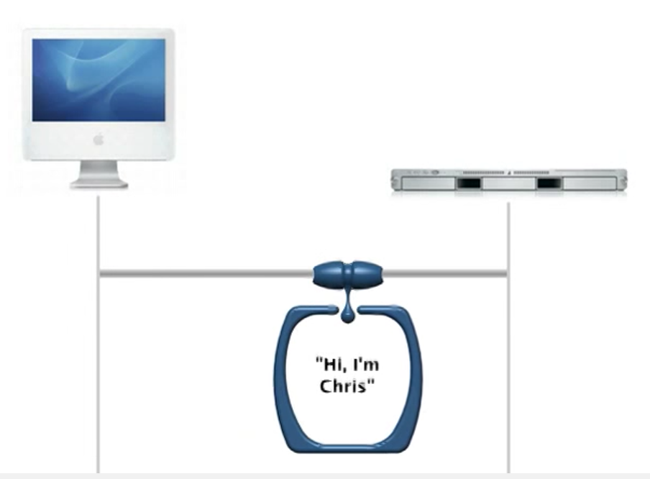

Slide 17
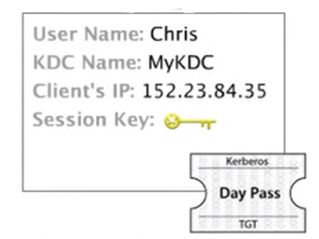
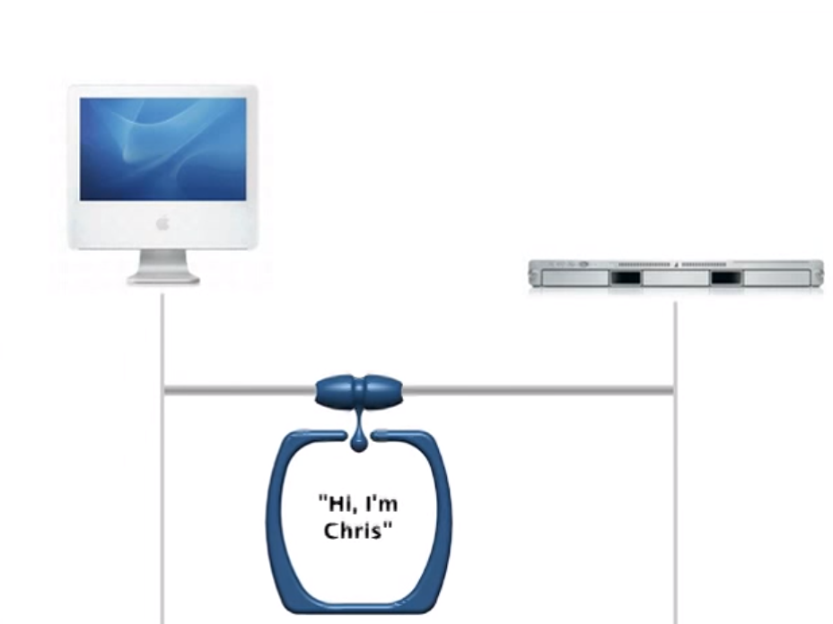
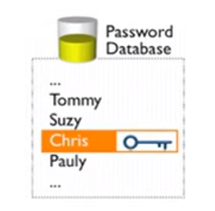

Slide 18
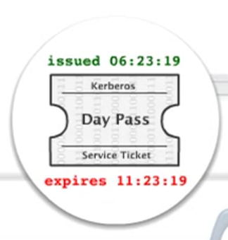
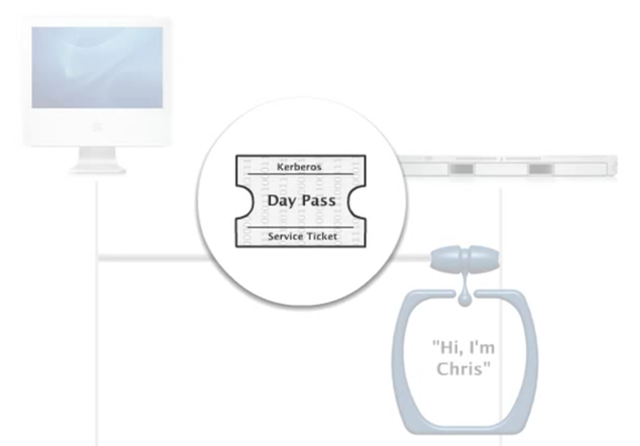
You need a valid ticket to access a resources because it proves your identity

Slide 19
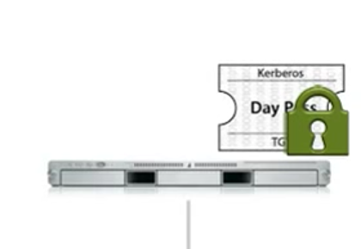
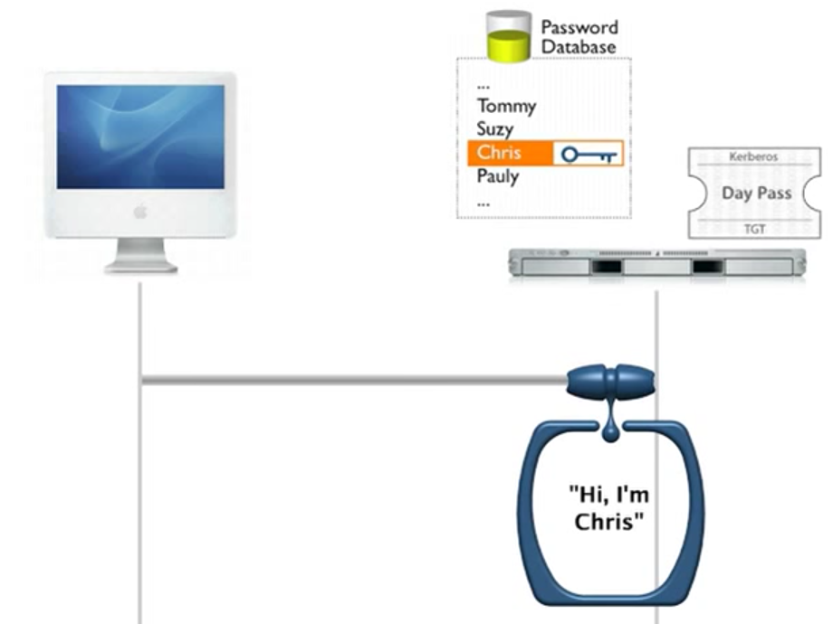

Slide 20
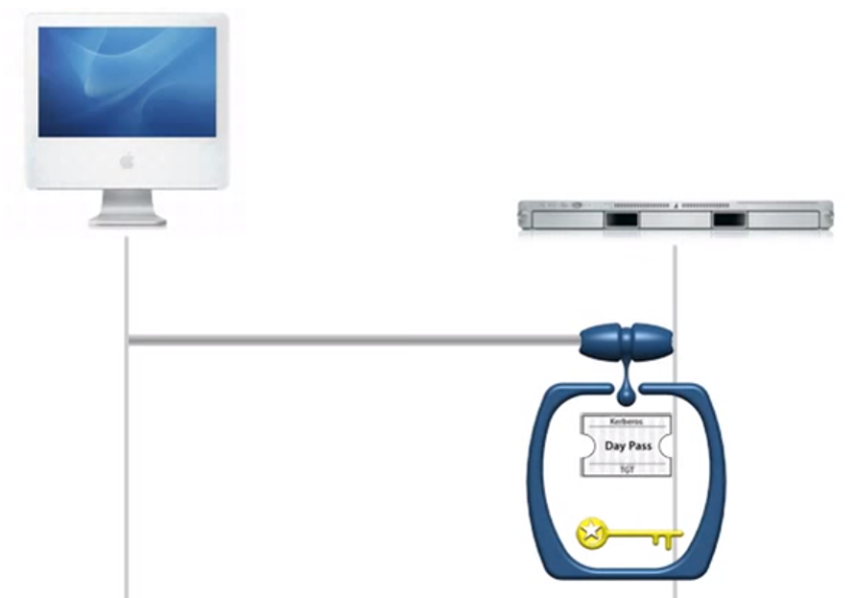

Slide 21
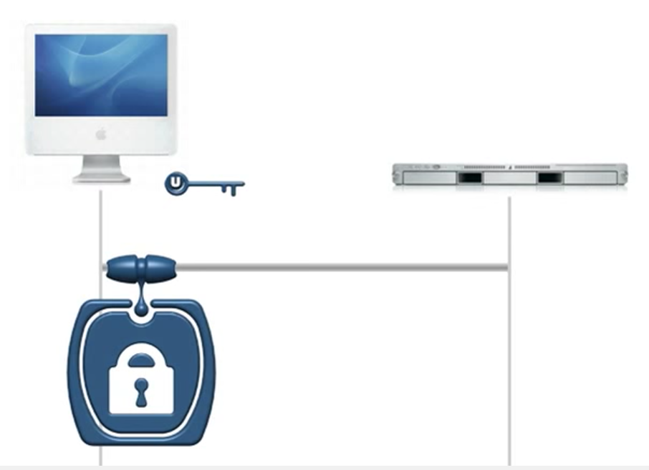
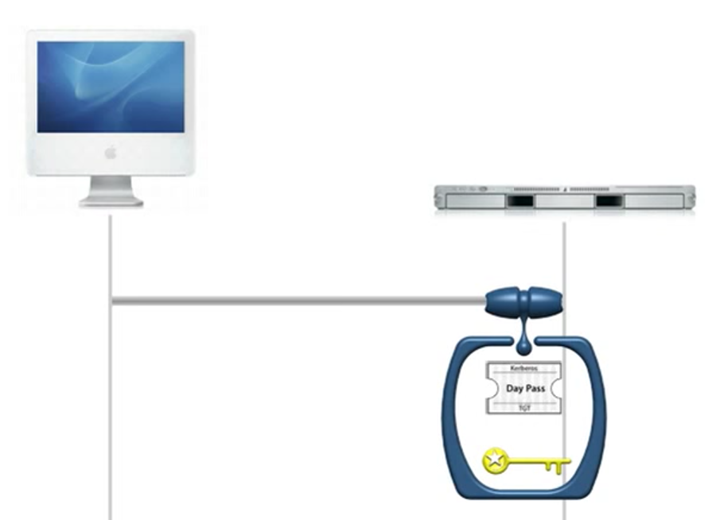
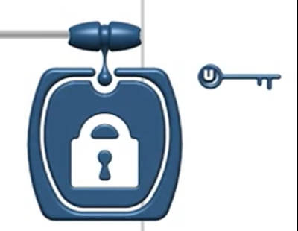

Slide 22
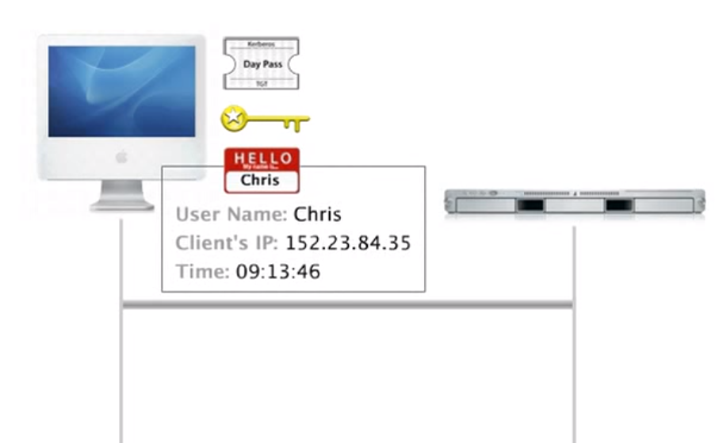

Slide 23
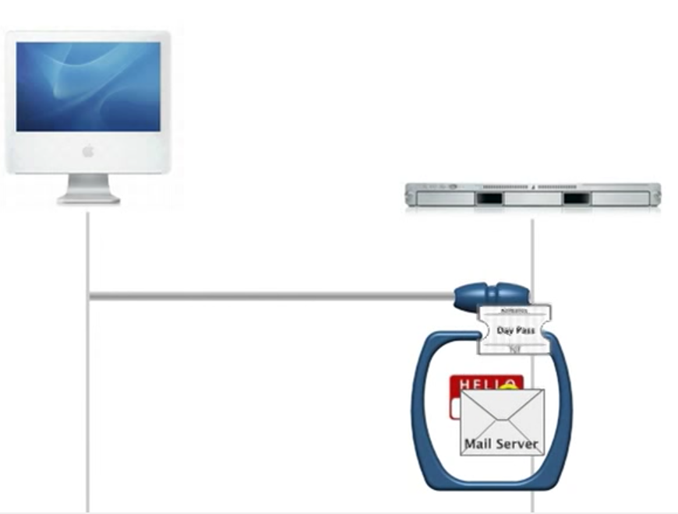
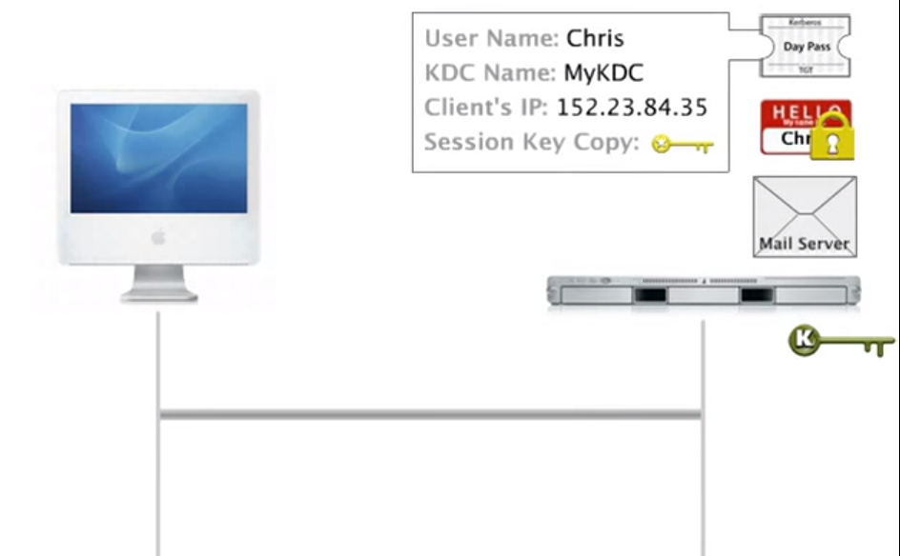
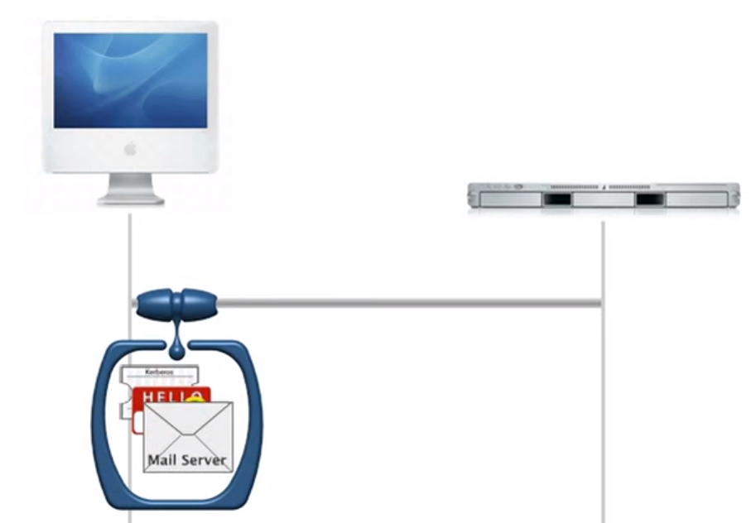

Slide 24
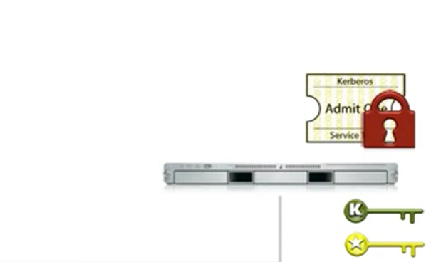
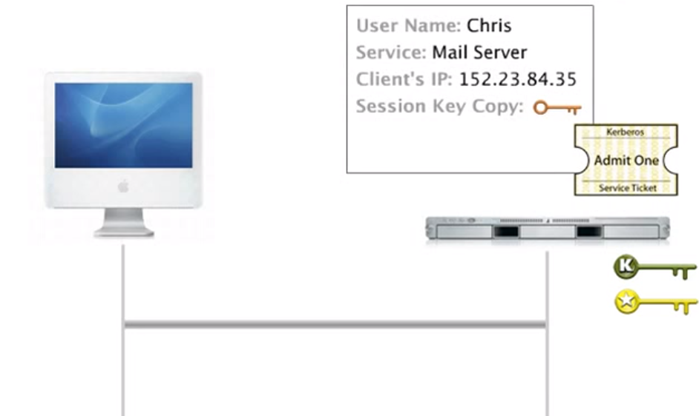
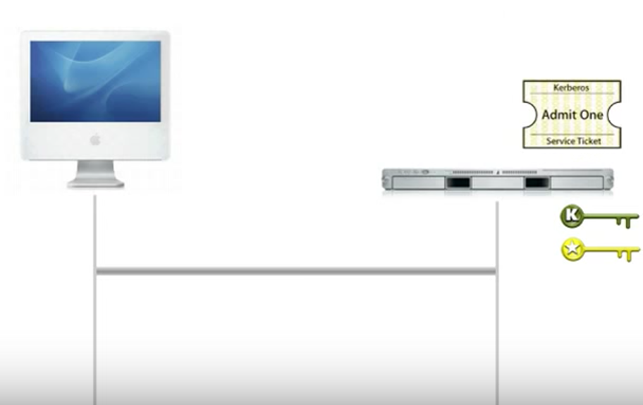

Slide 25
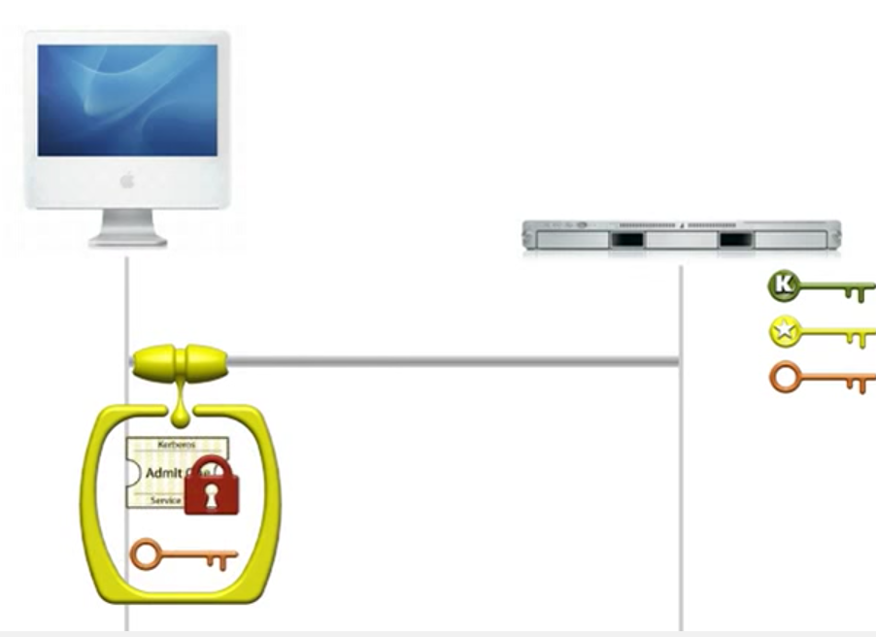
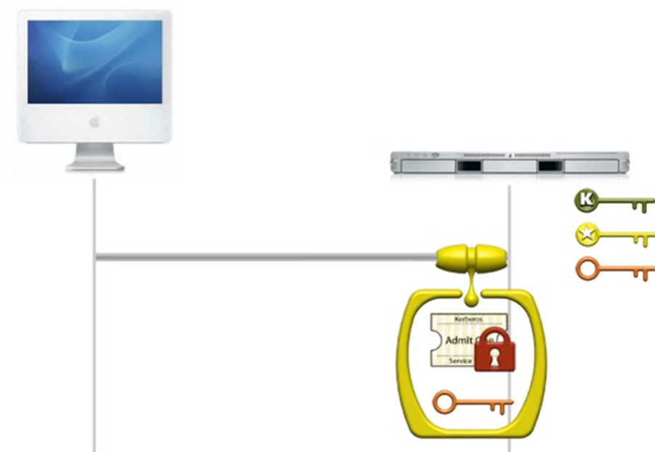
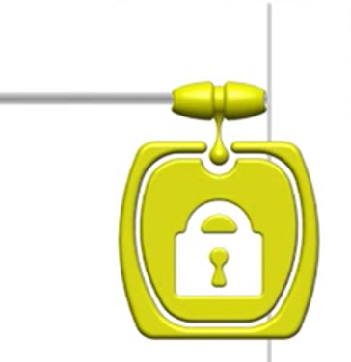

Slide 26
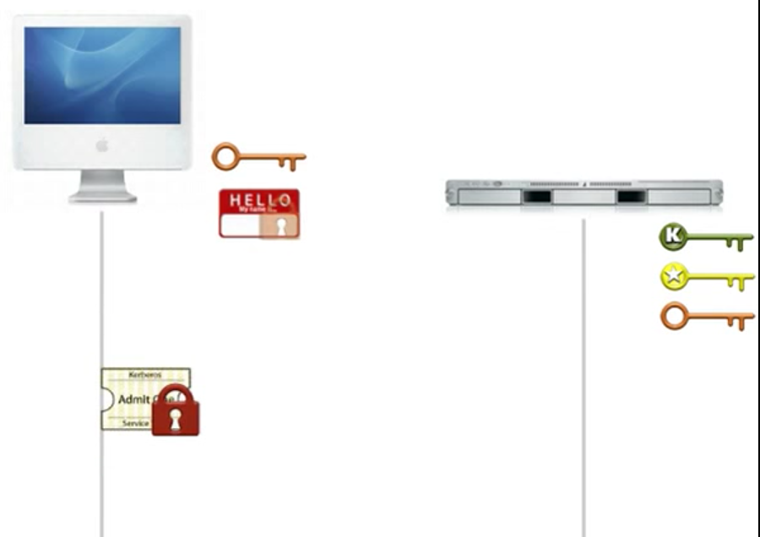

Slide 27
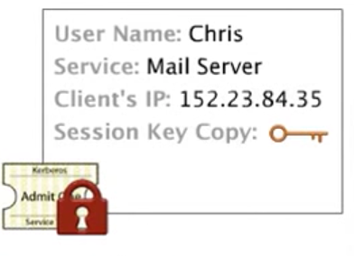
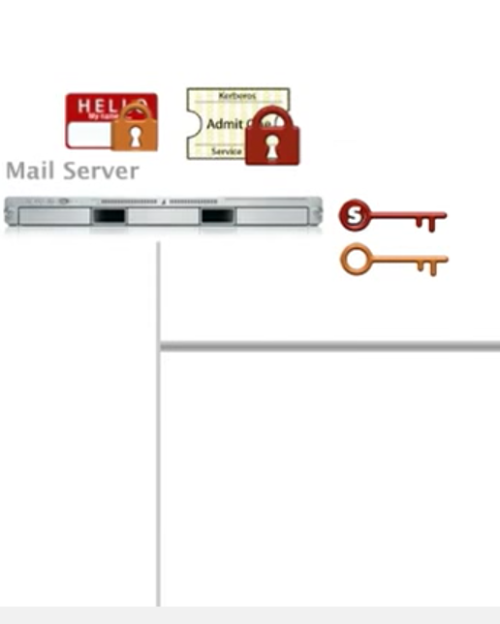
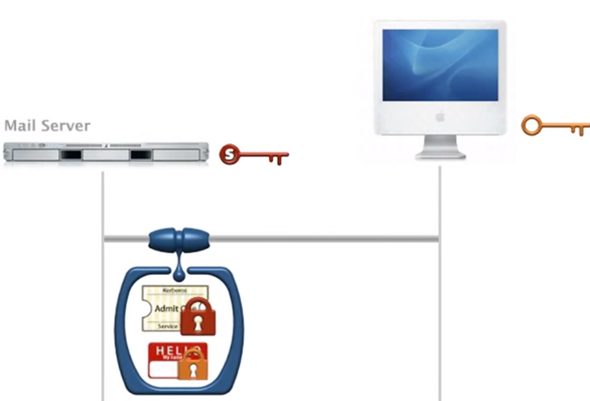
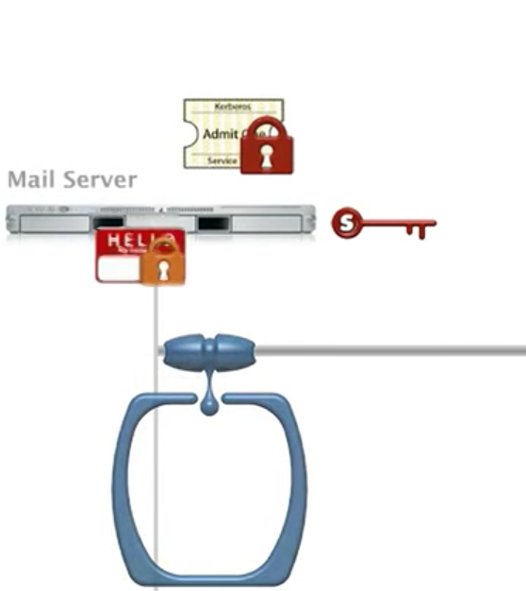
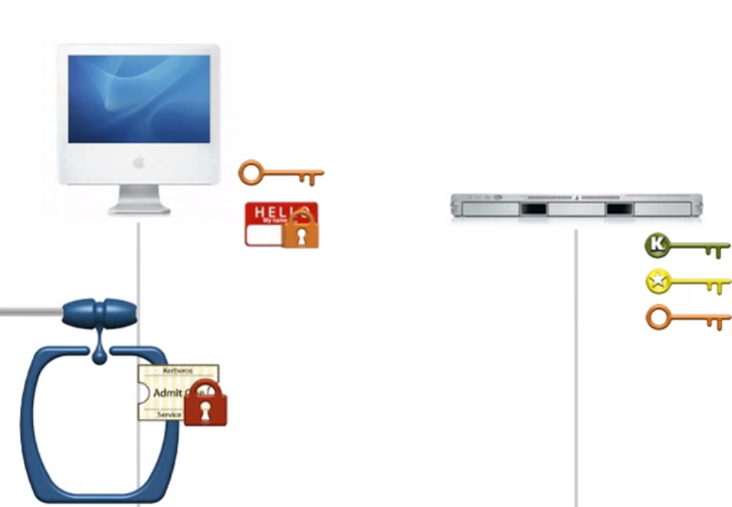

Slide 28
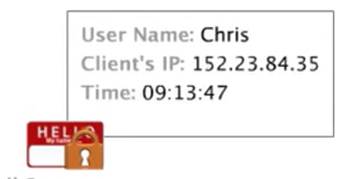
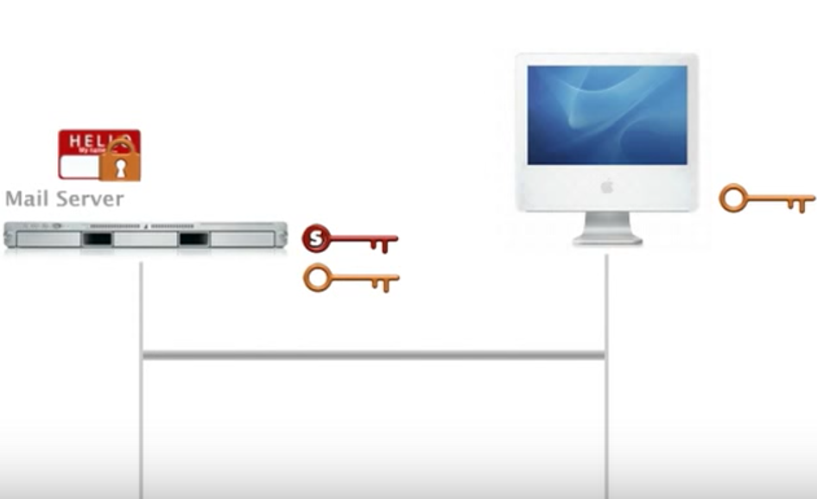

Slide 29
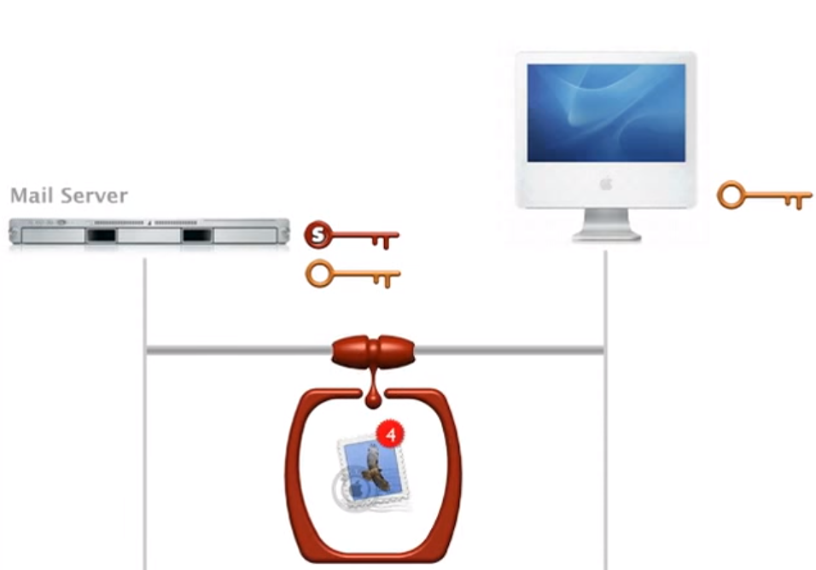

Slide 30
Implementation(Application):
Implementations of Kerberos are available from various vendors, Oracle, Apple Inc., Google, Microsoft, Centrify Corporation and TeamF1 Inc., and academic institutions such as the Royal Institute of Technology in Sweden, Stanford University, MIT, and vendors such as CyberSafe.
And it is freely accessible in open-source form. The standard MIT distribution includes a basic set of applications, including telnet, POP email, and the Berkeley UNIX "R-commands" (such as rlogin). Other applications can be "Kerberized" by incorporating calls to Kerberos library functions.

Slide 31
Advantage of kerberos:
Open sources code for kerberos
Eliminates the transmission of unencrypted passwords across the network
Eliminates the threat that packet sniffers would otherwise pose on a network.
Mutual Authentication

Slide 32
Drawback and limitation:
Password guessing
Single point of failure: It requires continuous availability of a central server
Kerberos has strict time requirements, which means the clocks of the involved hosts must be synchronized within configured limits.
Kerberos cannot be used in scenarios where users want to connect to services from unknown/untrusted clients as in a typical Internet or cloud computer scenario, where the authentication provider typically does not have knowledge about the user's client system.

Slide 33
Conclusion:
As a mature product, Kerberos has undergone significant revision.
Past (Version 1- 4)
MIT developed Kerberos to protect network services provided by Project Athena. The protocol is based on the earlier Needham–Schroeder symmetric key protocol. Several versions of the protocol exist; versions 1–3 occurred only internally at MIT. Kerberos version 4 was published in the late 1980s, although they had targeted it primarily for Project Athena.
Present (Version 5)
The last major revision, Kerberos Version 5, addressed many previously identified limitations:
Added support for forwardable, renewable, and postdated tickets.
Kerberos tickets can now contain multiple IP addresses and addresses for different types of networking protocols.
Replay caches keep track of recently issued tickets and do not allow the same ticket to be used twice in a row.
There is now support for transitive cross-realm authentication which removes the requirement that each pair of realms that wish to allow authentication must share a secret.

Slide 34
Future (Version ?)
Kerberos' many strengths are attested to by its wide adoption as an industry standard.
It seems certain to continue to play a role in small networks with strict authentication requirements.
In the broader Internet context, however, SSL seems already to have achieved de facto standard status.
Even with technical improvements in its scalability, Kerberos may remain restricted to the small network context.

Slide 35
Reference
http://www.obscure.org/~jafitz/250_p1/kerberos.htm
http://web.mit.edu/rhel-doc/5/RHEL-5-manual/Deployment_Guide-en-US/ch-kerberos.html
https://www.sans.org/reading-room/whitepapers/windows/overview-kerberos-authentication-proto-1288
https://en.wikipedia.org/wiki/Kerberos_(protocol)
http://www.kerberos.org/software/whykerberos.pdf
http://www.kerberos.org/about/FAQ.html
https://www.youtube.com/watch?v=KD2Q-2ToloE

Slide 36
Thank you!

